Slide 1
Excavations at Samuel Moniac’s House on the Old Federal Road
Presented at the
Alabama Historical Association 2012 Annual Meeting
April 14, 2012, in Huntsville, Alabama
by Raven Christopher, Archaeologist
University of South Alabama
Center for Archaeological Studies

Slide 2
The Old Federal Road

Slide 3
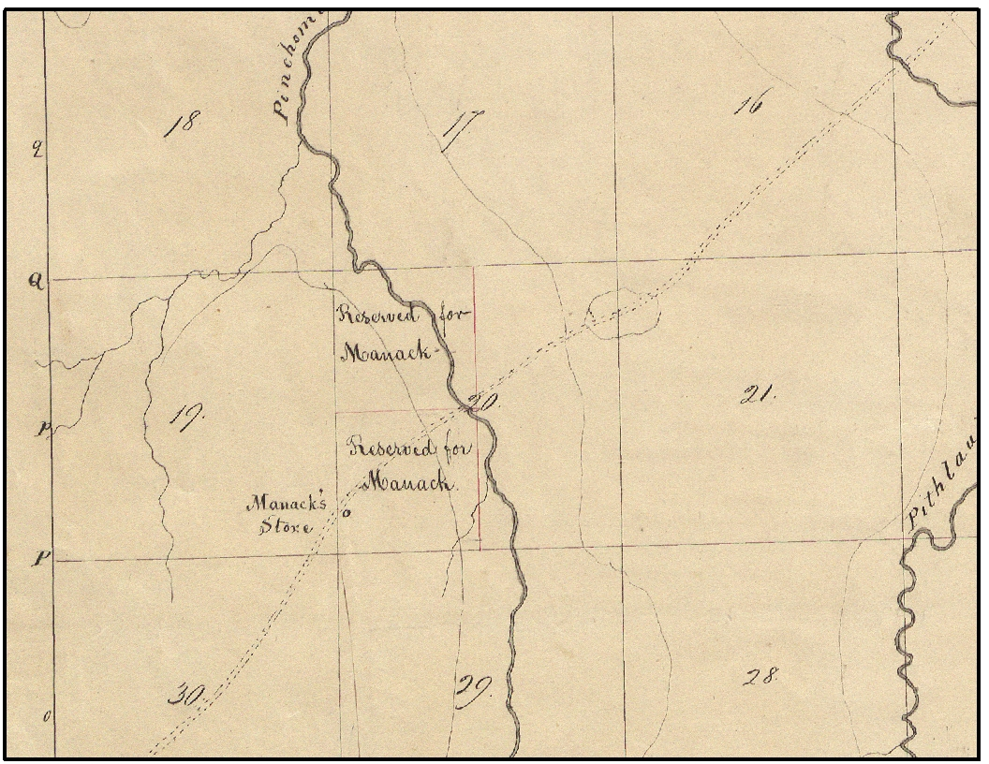
Samuel Moniac’s (Manack’s) Store on Survey Plat (circa 1817)

Slide 4
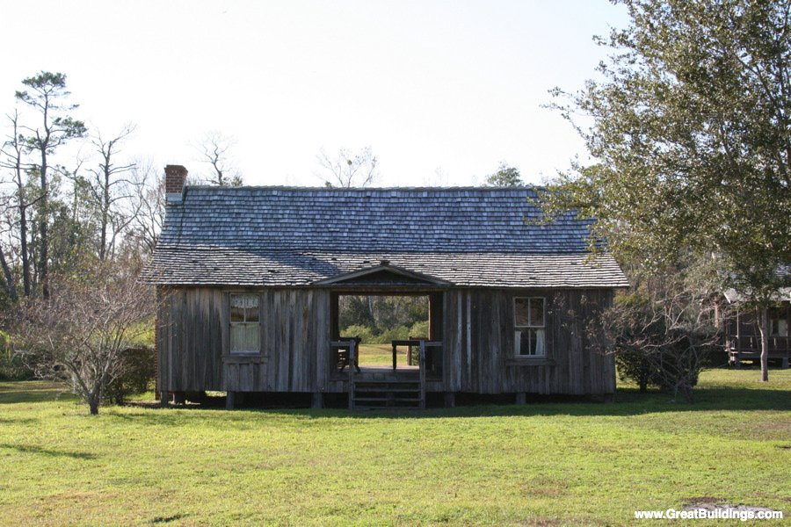
Typical Dog-Trot Style House

Slide 5
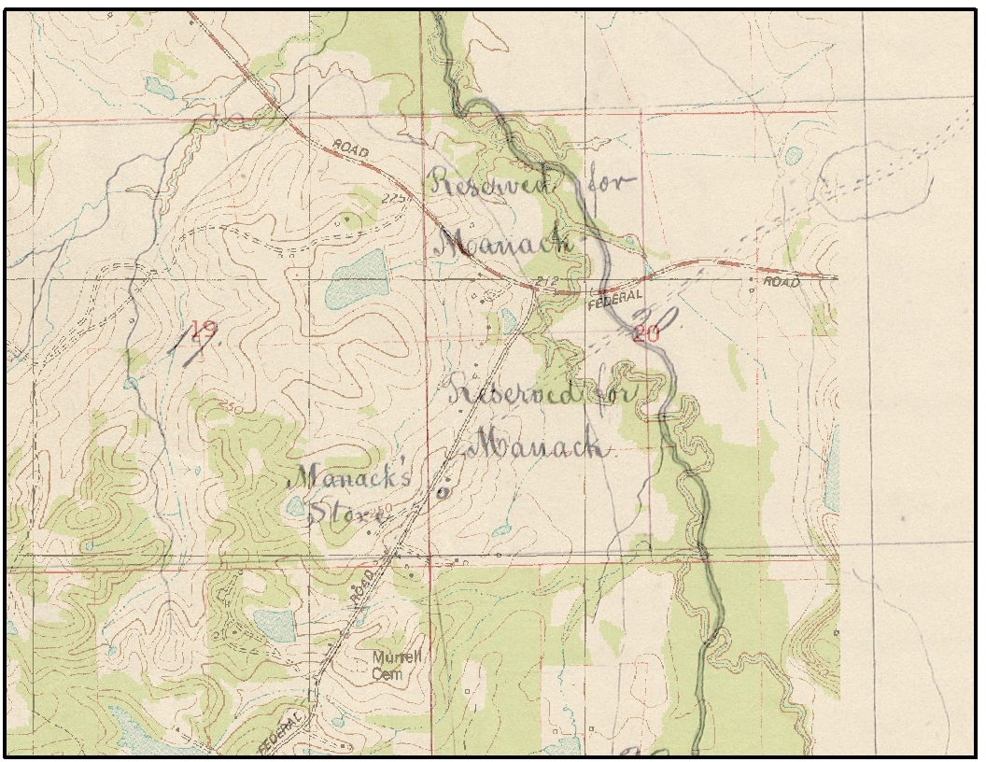
Survey Plat on Modern Topographic Map

Slide 6
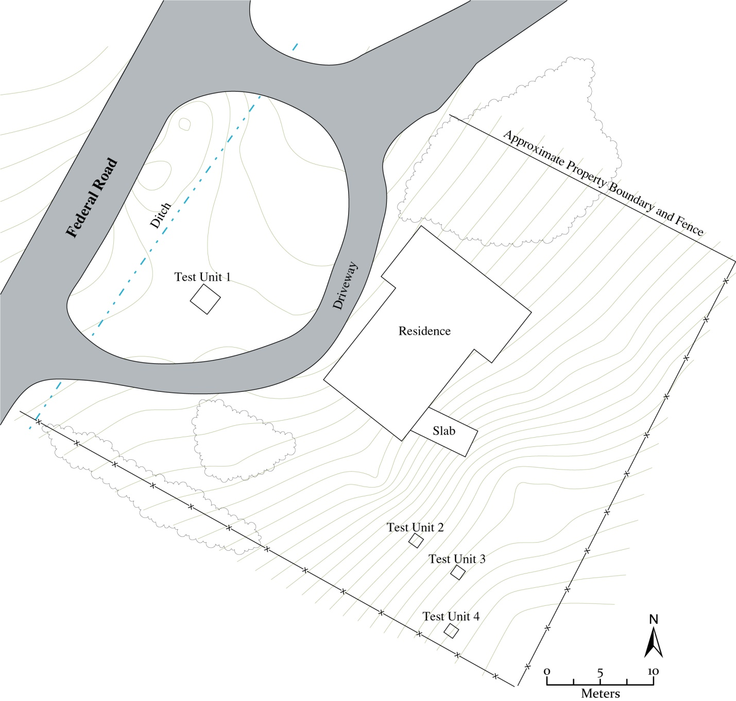
Moniac House Site Excavation Map

Slide 7
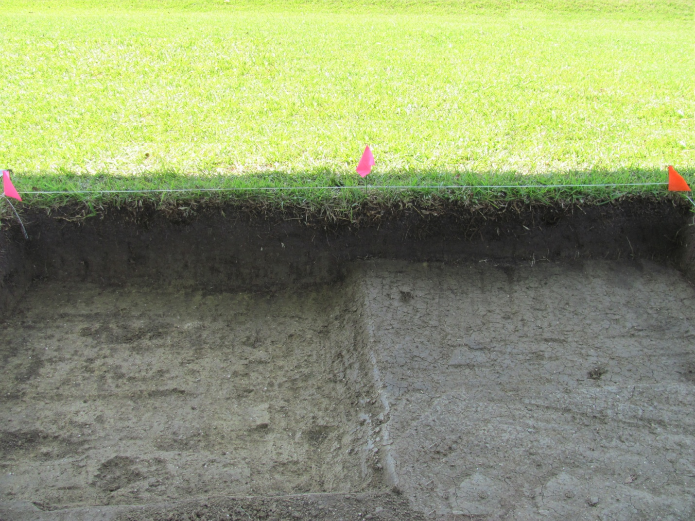
Test Unit 1

Slide 8
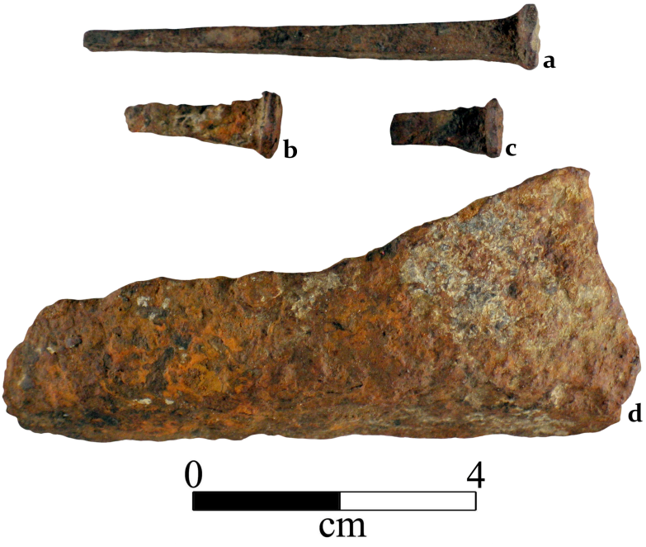
Iron Artifacts

Slide 9
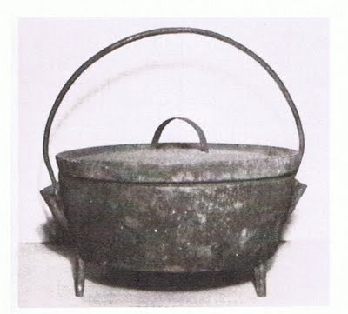
Cast Iron Dutch Oven

Slide 10
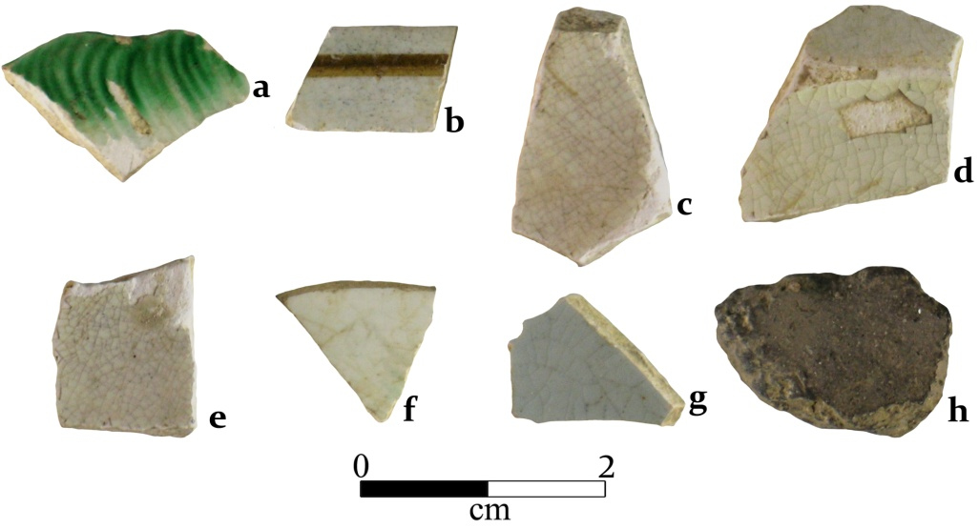
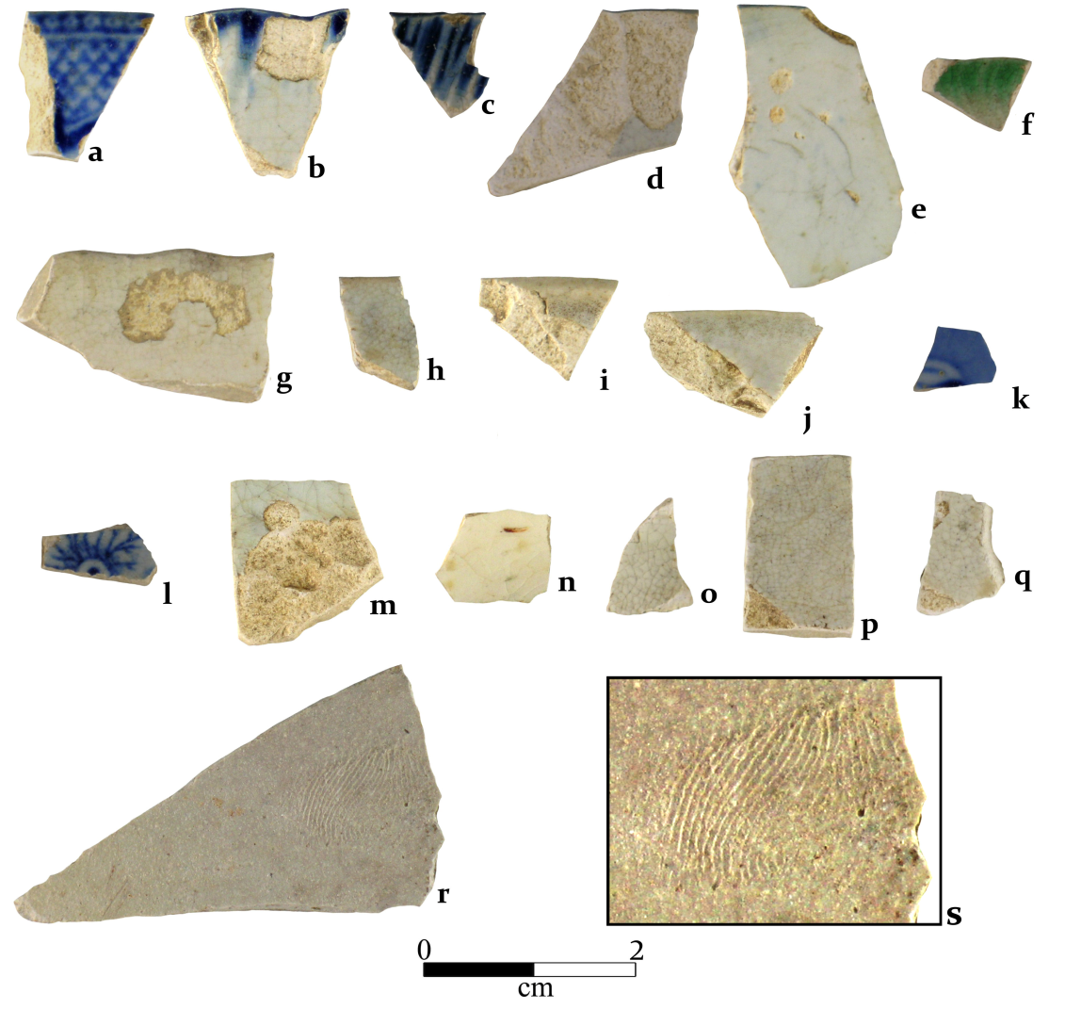
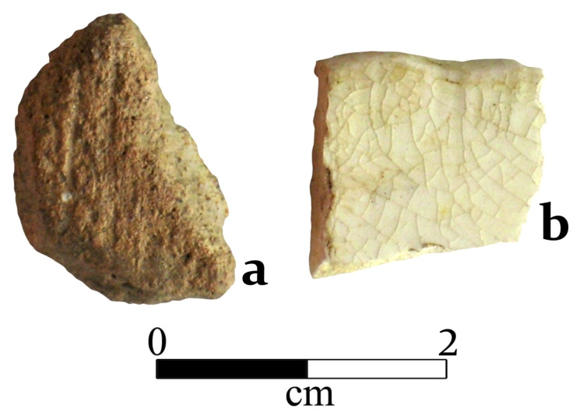
European and Creek Pottery

Slide 11
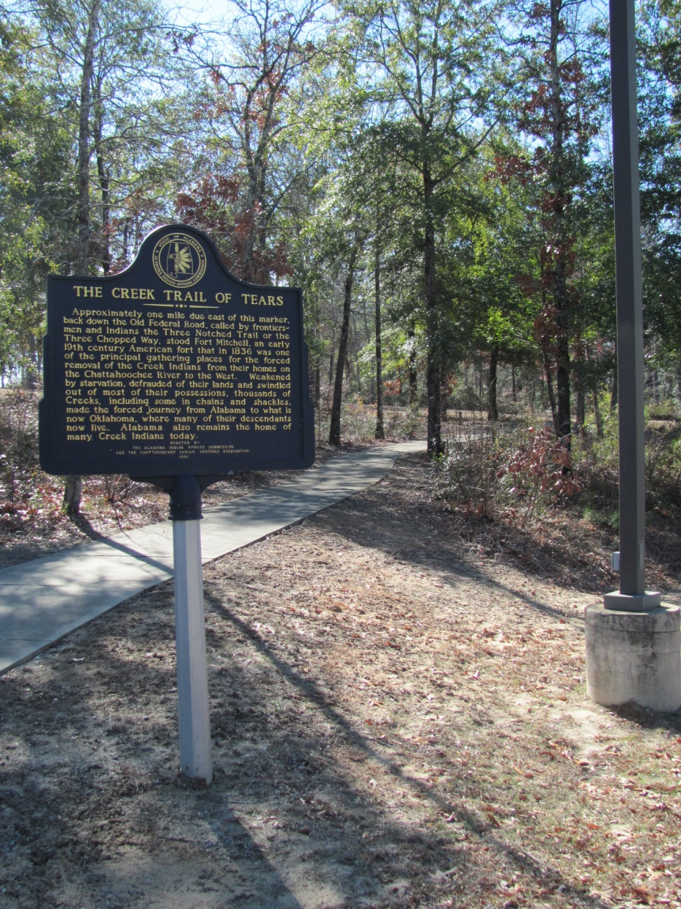
Conclusions
Samuel Moniac
Born: 1779 in the Creek Nation, AL
Died: 1836 near Pass Christian, MS on
the Creek Trail of Tears

Slide 12
Acknowledgements
The historic research and archaeological survey of the Old Federal Road was funded by a Transportation Enhancement grant from the Alabama Department of Transportation, with funding derived from the American Recovery and Reinvestment Act. Additional financial support was provided by two grants from the American Battlefield Protection Program, National Park Service, U.S. Department of the Interior. Funding for the archaeological excavations at Samuel Moniac’s house was provided by the Pintlala Historical Association.
References
Christopher, Raven, Gregory Waselkov, and Tara Potts. Archaeological Testing along the Federal Road:
Exploring the Site of “Manack’s Store,” Montgomery County, Alabama . Report prepared for the Pintlala
Historical Association. Mobile, Al: University of South Alabama, Center for Archaeological Studies, 2011.

